Slide 1

Amazon's Best Books Seller
Priyatham Bikumalla
Arjun Sahas

Slide 2






Content
Problem and Solution
Why it is important & Beneficial
Implementation
Results
Conclusion

Slide 3

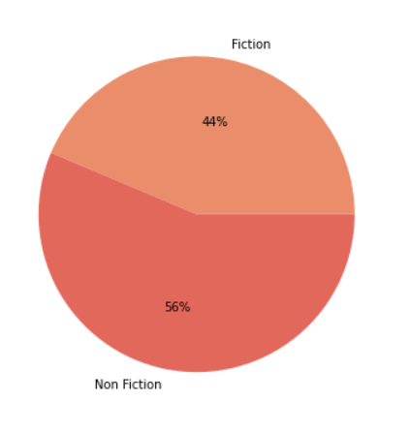
Understanding the Problem
Deduce a comparison between the best-selling books against two major categories, fiction and nonfiction
We want to understand the nature of best seller books in Amazon to see users preference towards reading in 2009–2019.

Slide 4

Dataset
Data Mining Task:
Binary Classification
Data:
Kaggle (https://www.kaggle.com/sootersaalu/amazon-top-50-bestselling-books-2009-2019)
Number of instance: 550
Number of Attributes: 7
The last column denotes whether genre is fiction or nonfiction

Slide 5
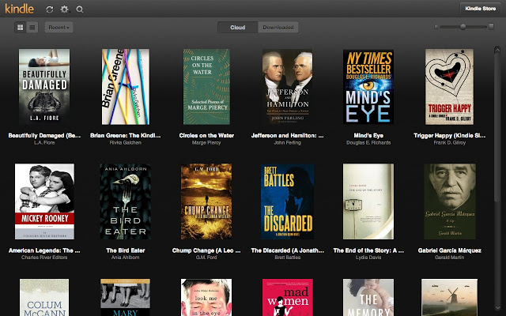
Why it is important
Therefore, the organizations bestselling books dataset has been extracted and predict to help the management analysed the future business trend and have clear insights regarding its performance over the period provided in the data
The criteria is to help Business Owners to be successful by through the awareness of market trends and customer needs.
How will it be beneficial?
Through this dataset we can use Machine Learning Algorithms to predict the genre of a given book.
Improved operational efficiency, improved customer satisfaction, drive for innovation and maximizing profits are only a few of the many benefits of using Machine Learning.
Reliable & Scalable- Analysing the patterns and trends from the dataset to drive smart business decisions and changes.

Slide 6







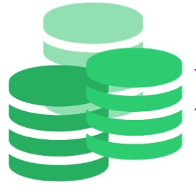



Pipeline
Exploratory Data
Analysis
Fiction
Prediction
Input Data
Non - Fiction
Pre-processed
Data
Algorithms

Slide 7
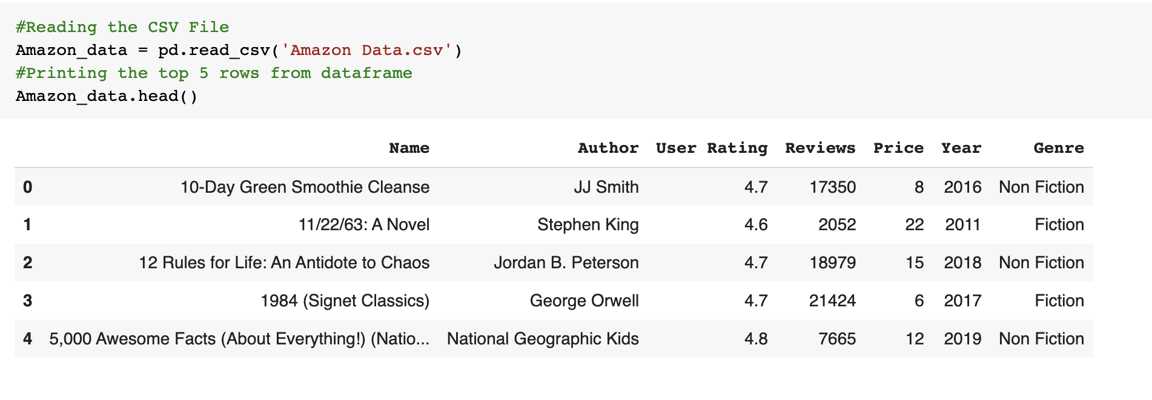
Reading The File

Slide 8
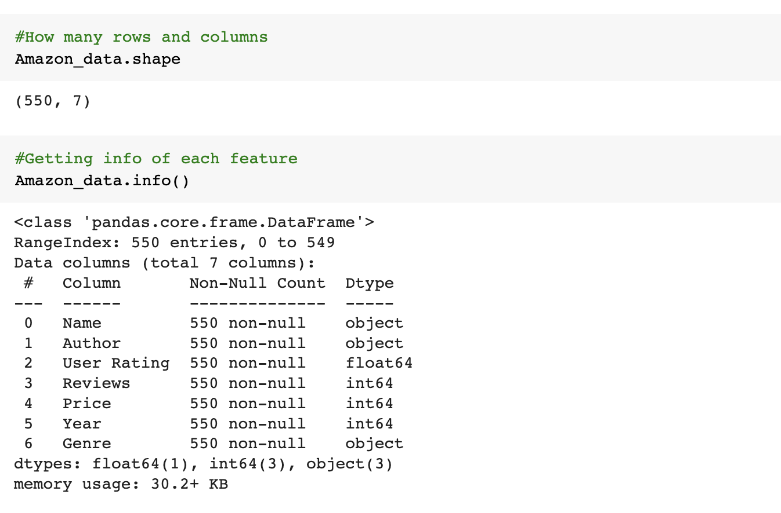
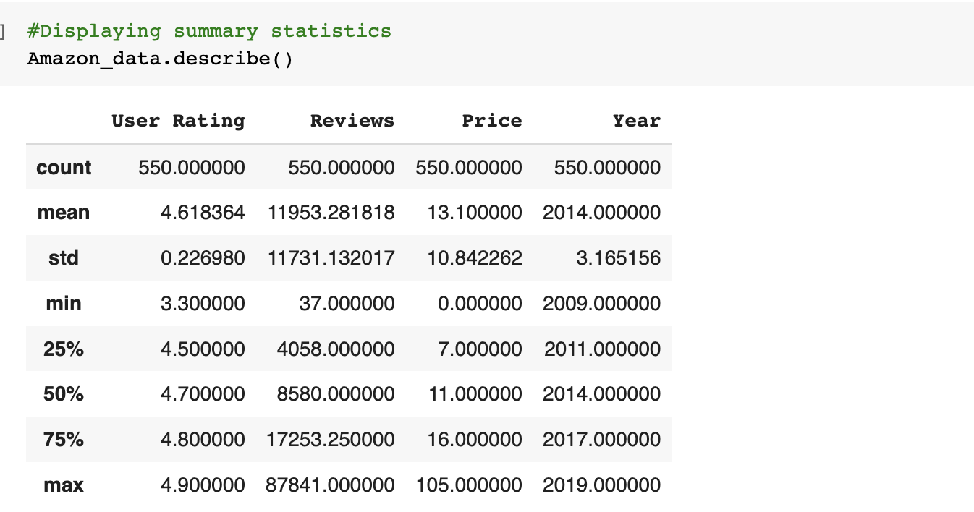
Data Pre-Processing
Getting the rows and columns.
Knowing the data Type.
Summary of the dataset.

Slide 9
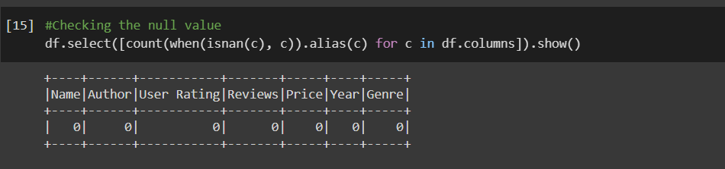
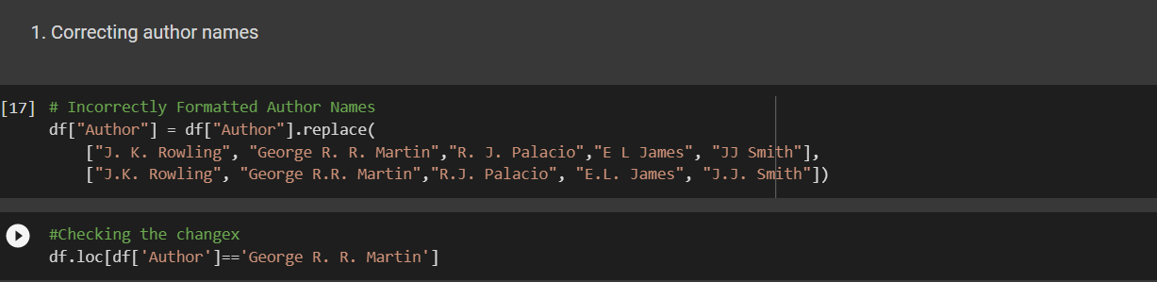
Data Pre-Processing
Checking the null values.
Making the dataset in proper format

Slide 10
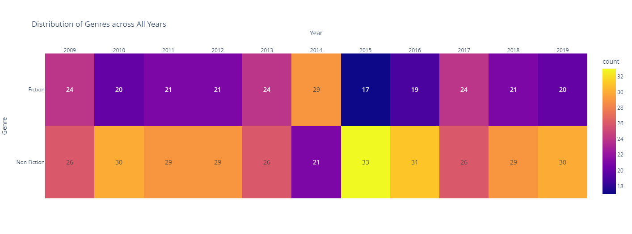
Exploring the Dataset
Genres distribution across 2009-19

Slide 11
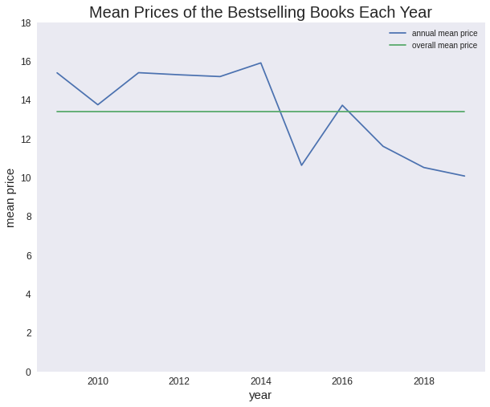
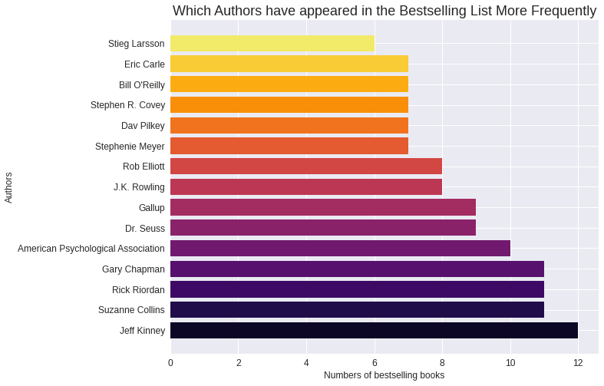
Exploring the Dataset
Jeff Kinney appeared in the list most often
we can observe the overall trending is going down, implying the prices of bestselling books are decreasing in recent years.

Slide 12
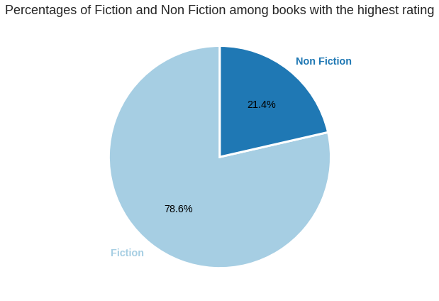
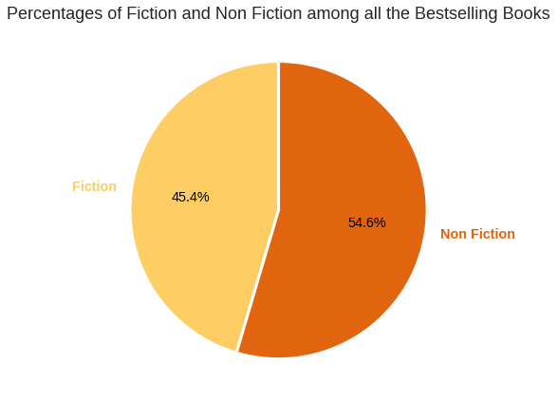
Exploring the Dataset

Slide 13
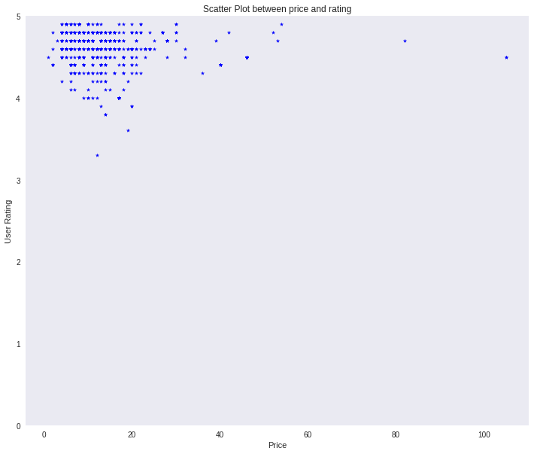
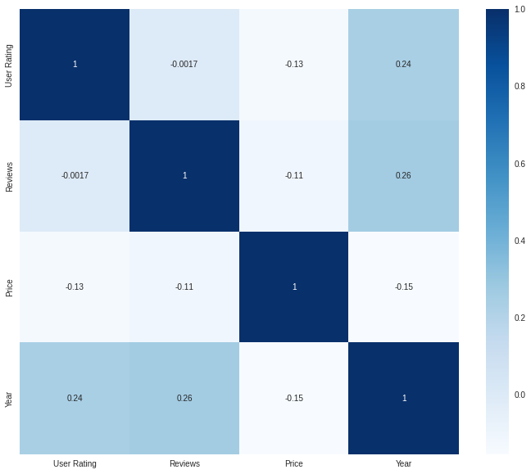
Exploring the Dataset
Relationship between the features
clustered in the upper left corner----nonlinear relationship, and not highly-correlated implying that books won't become more expensive just because of higher ratings. or be devaluated due to poor ratings

Slide 14
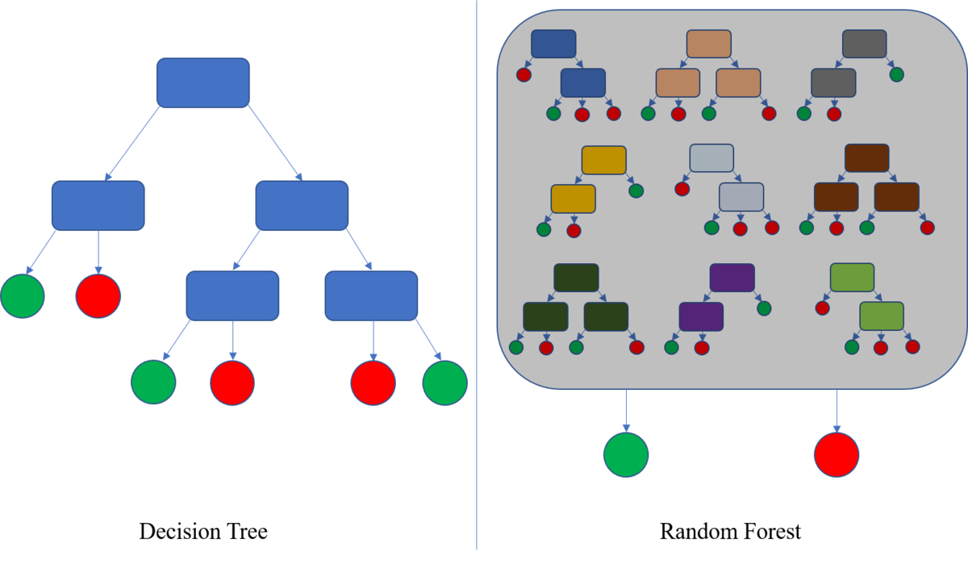
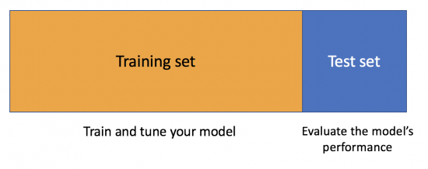
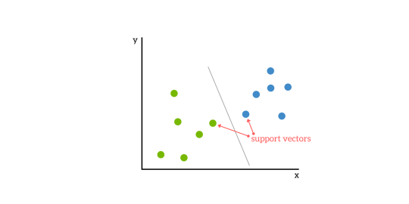
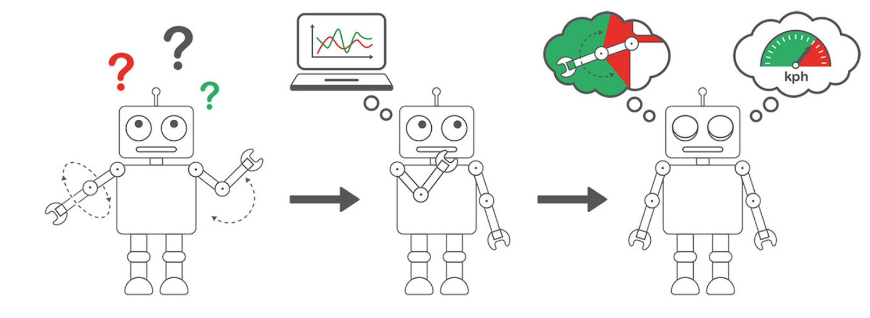
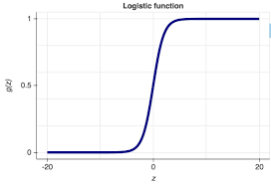
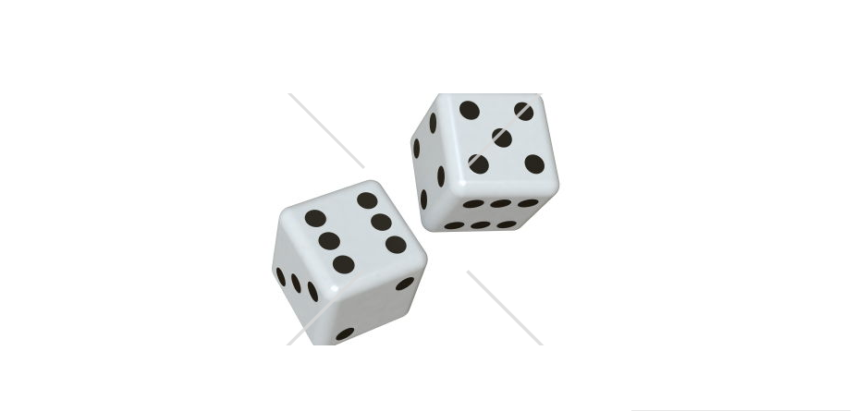
Machine Learning Algorithm
80%
20%
Decision Tree
Random Forest
Applying different model to dataset
Support Vector Machine
Logistic Regression
KNN

Slide 15
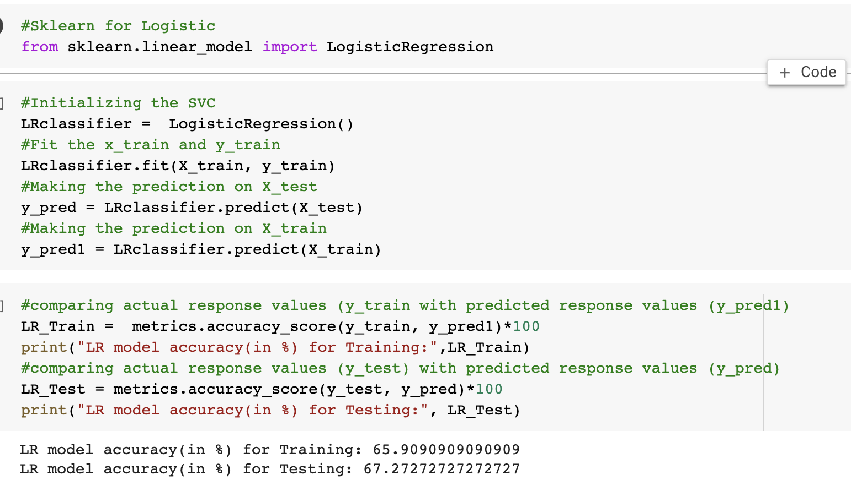
Implementation Example: Logistic Regression
Applying the Algorithm

Slide 16
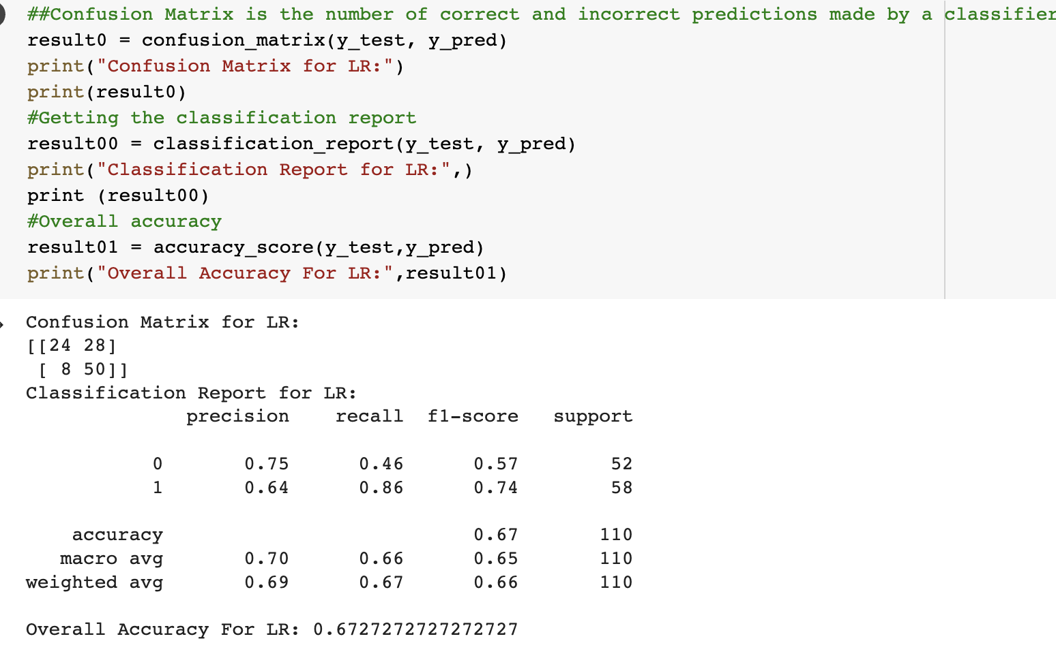
Implementation Example: Logistic Regression
Classification Report

Slide 17
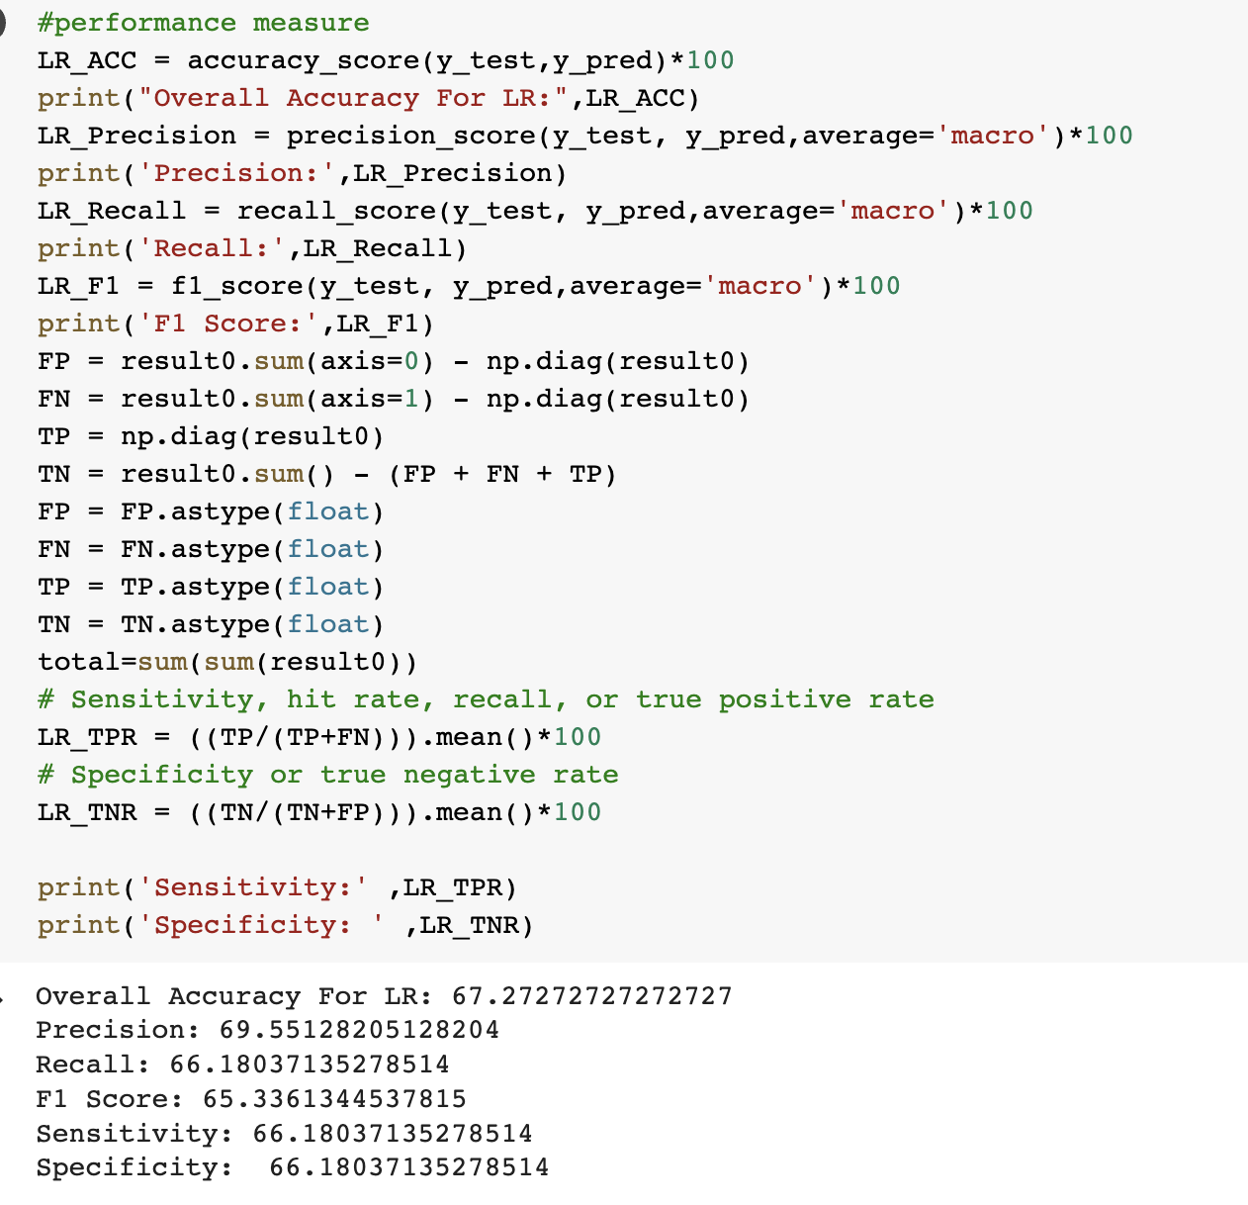
Implementation Example: Logistic Regression
Performance Metrics

Slide 18
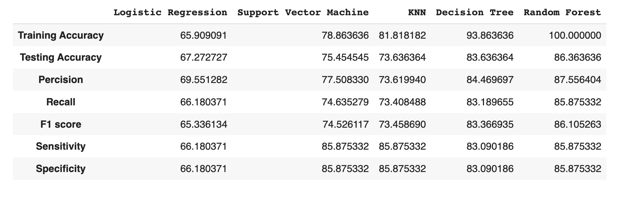
Comparison
Comparison
The best classifier of accuracy is the Random Forest

Slide 19
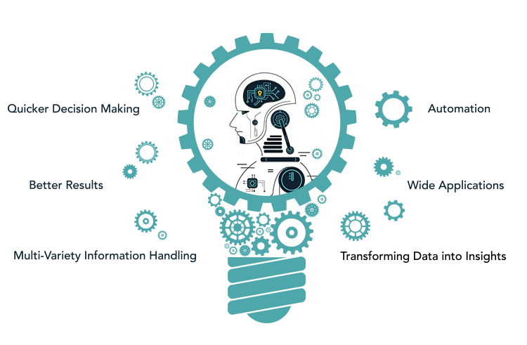
Conclusion
Number of reviews increased at a huge pace after year 2012
we analyzed the possible aspects of amazon selling book
Even the author with the lowest mean user rating has a score of 3.9 which shows that books featured in this list are of high quality.
Explore connections between different features such as ratings, price.
248 different authors was featured
Authors whose books are featured in top 10 of the user rating list has same mean user rating 4.9

Slide 20



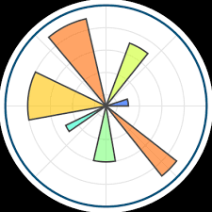


Toolkit Breakdown
Platform
Programming Language
Algorithm
Google Colab
Python
Decision Tree and many more
Data Visualization
Dataset
Evaluation and Comparison
Matplotlib
Seaborn
Amazon’s top best selling books from 2009-2019 Dataset
Performance
F1and many more

Slide 21

Thank You

